Slide 1
"Forecasting Financial Choices: Predicting Term Deposit Subscriptions"
K.Karunasagar

Slide 2
Project Background and context
In today's competitive banking environment, understanding customer behavior is crucial for designing effective marketing strategies.
This project focuses on analyzing a dataset from a recent marketing campaign aimed at encouraging customers to subscribe to term deposits.
By examining various customer attributes, we aim to uncover patterns and predict which individuals are most likely to subscribe to a term deposit.

Slide 3
Solution
The primary aim of this project is to harness the power of data analytics to enhance the effectiveness of marketing campaigns targeted at promoting term deposit subscriptions.
Predict who subscribes: Target the right people with term deposit promotions.
Group customers: Tailor messages based on needs and preferences.
Understand why they subscribe: Craft marketing that resonates with motivations.
Get more out of marketing budget: Focus efforts on high-potential customers.
Learn for future success: Continuously improve marketing campaigns.

Slide 4
Goal
Predictive Analysis: Develop models to predict the likelihood of a customer subscribing to a term deposit based on their attributes.
Customer Segmentation: Identify key segments within the customer base that are more likely to convert.
Strategic Insights: Provide actionable insights for optimizing future marketing campaigns, improving customer targeting, and increasing conversion rates.

Slide 5
Benefits
Increased Conversion Rates: Target the right people with relevant promotions, leading to more subscriptions.
01
Enhanced Marketing ROI: Focus resources on high-potential customers, maximizing marketing budget impact.
02
Improved Customer Segmentation: Craft personalized messages based on needs and preferences, leading to higher engagement.
03
Data-Driven Decision Making: Gain insights into customer motivations for informed product and marketing strategies.
04
Reduced Risk and Costs: Avoid unnecessary marketing efforts, focusing on more promising customers.
05

Slide 6
Exploratory Data Analysis(EDA)
The average customer is around 40 years old
A higher percentage of customers might be married
The data suggests a diverse range of job types among the customers.
A small percentage of customers have loan defaults“
The average customer has a balance of around $1362.
The balance might be skewed towards higher values.

Slide 7

Exploratory Data Analysis(EDA)
On average, there have been 2 contacts per customer this campaign.
A significant portion of customers might have housing loans
Previous contacts were primarily cellular or telephone
A significant portion of customers may have had unknown outcomes in previous campaigns
The data shows that 17% of customers are currently subscribed to term deposits

Slide 8
Diagnosis analysis
Correlation Matrix: A correlation between higher balances and subscriptions might suggest customers with more savings are more receptive to investment opportunities.
Actionable Recommendations: Based on your findings, provide actionable recommendations for marketing strategies. For example, suggest targeting customers with higher balances with personalized offers for term deposits.

Slide 9
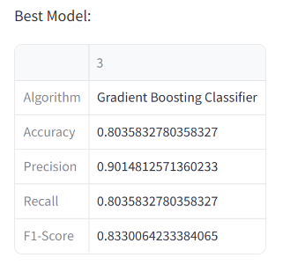
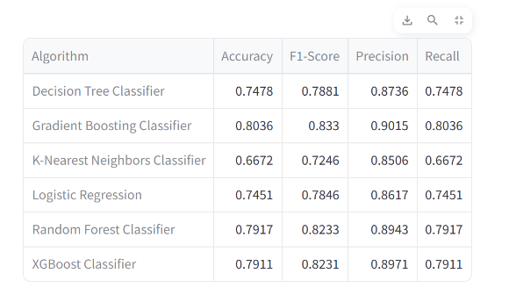
Model Comparision
The table compares the accuracy, F1-score, precision, and recall of five different classification algorithms: Decision Tree Classifier, Gradient Boosting Classifier, K-Nearest Neighbors Classifier, Logistic Regression, and Random Forest Classifie
For this specific task of classifying trees, the table shows that the Gradient Boosting Classifier which is a machine learning technique used in regression and classification problems.
The classifier achieved an accuracy of 0.803, precision of 0.901, recall of 0.803, and F1 score of 0.833.

Slide 10
Predictive Analysis
Increase Subscription Rates:
By accurately predicting which customers are likely to subscribe, we can tailor marketing efforts to the right audience, thereby increasing the overall subscription rate.
Optimize Marketing Resources:
Focus marketing efforts on high-potential customers, reducing wasted resources on unlikely subscribers. This optimization will lead to more efficient use of marketing budgets.
Enhance Customer Experience:
Personalize marketing messages and offers to meet the specific needs and preferences of different customer segments, improving customer satisfaction and engagement.
Provide Actionable Insights:
Generate insights into the factors influencing customer decisions, enabling the marketing team to design more effective and targeted campaigns in the future.
Improve ROI:
Achieve a higher return on investment (ROI) for marketing campaigns by increasing conversion rates and reducing costs associated with broad, untargeted marketing efforts.

Slide 11
Conclusion based on analysis
This data exploration provides valuable insights into the characteristics and potential behaviors of our customer base for term deposits.
We can identify trends in customer demographics, financial information, and marketing interactions.
By analyzing the relationships between these factors and subscription likelihood, we can develop targeted marketing strategies to reach the most promising customer segments.
This targeted approach can increase the efficiency and effectiveness of our marketing efforts, leading to a higher conversion rate for term deposit subscriptions.

